Slide 1
Introduction Spring Security
Cornelis de Mooij

Slide 2
Planning
Theory:
Hashing
Hashing & salting
Authentication & Authorization
Asymmetric cryptography
Public Key Encryption
Digital Signatures
Practice:
Spring application with username & password
Spring application with authorization-token (JWT)
Spring application with service-service authorization with OAuth

Slide 3


✓ Planning
Any Questions?

Slide 4

Hashing

Slide 5
Hashing
What is hashing?
How does hashing work?
Applications of hashing
Attacks on hashing
Hashing & salting
Attacks on salted hashing
The last defense

Slide 6
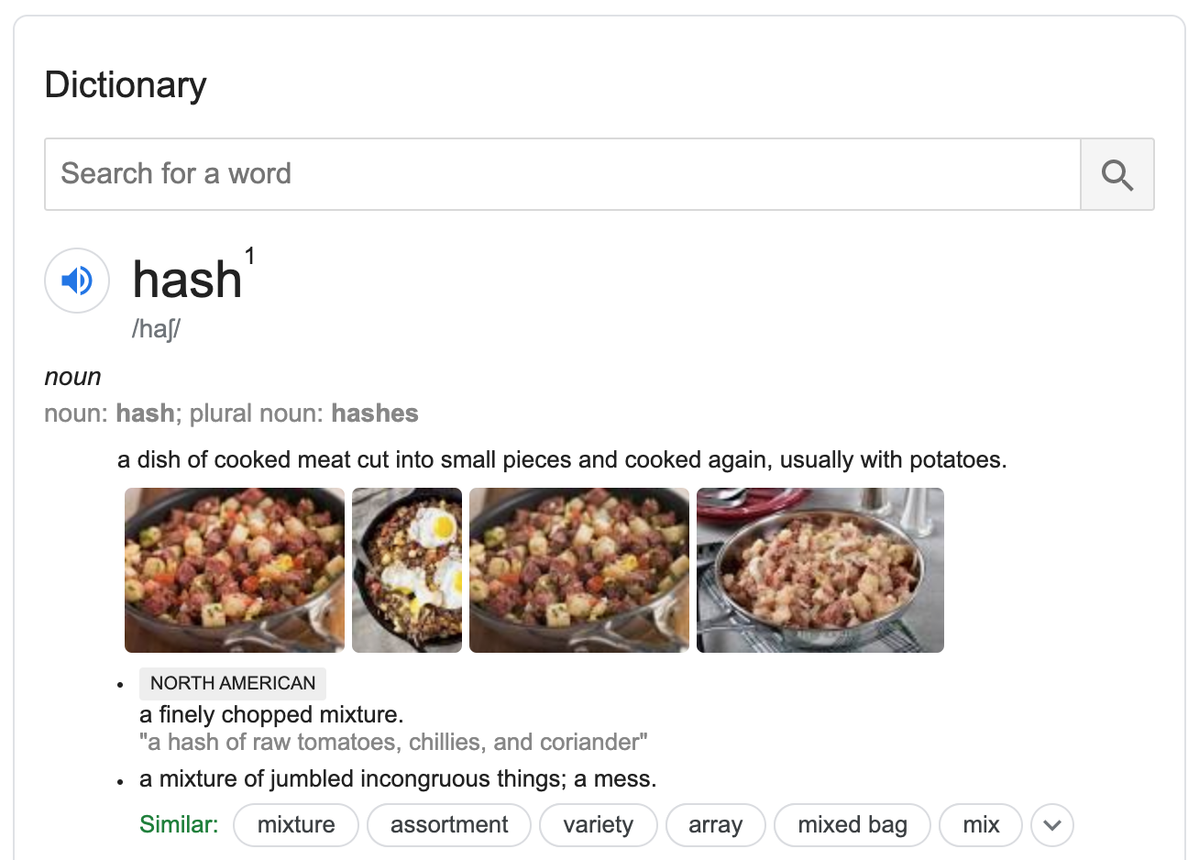
What is hashing?

Slide 7
What is hashing?
A way to turn data of any size into something with a fixed size
For security, that’s not enough. Should also be hard to:
Find input for a specific output
Find different input that produces the same output
Find two different inputs that produce the same output
Then, it’s “Cryptographic Hashing”

Slide 8
How does hashing work?
Many methods
Focus on one modern cryptographic hash: SHA-512
Complicated, don’t worry about implementing it, we won’t. Just for illustration.

Slide 9
Hashing with SHA-512
Pad message with (100…000) and message length
Cut padded message into 1024-bit blocks
Set previous hash to 512-bit initial vector (IV, SHA-512 constant)
Loop over blocks:
Combine previous hash and block with “Rounds and Addition”
Store resulting hash as previous hash and repeat
Return resulting hash from last block

Slide 10
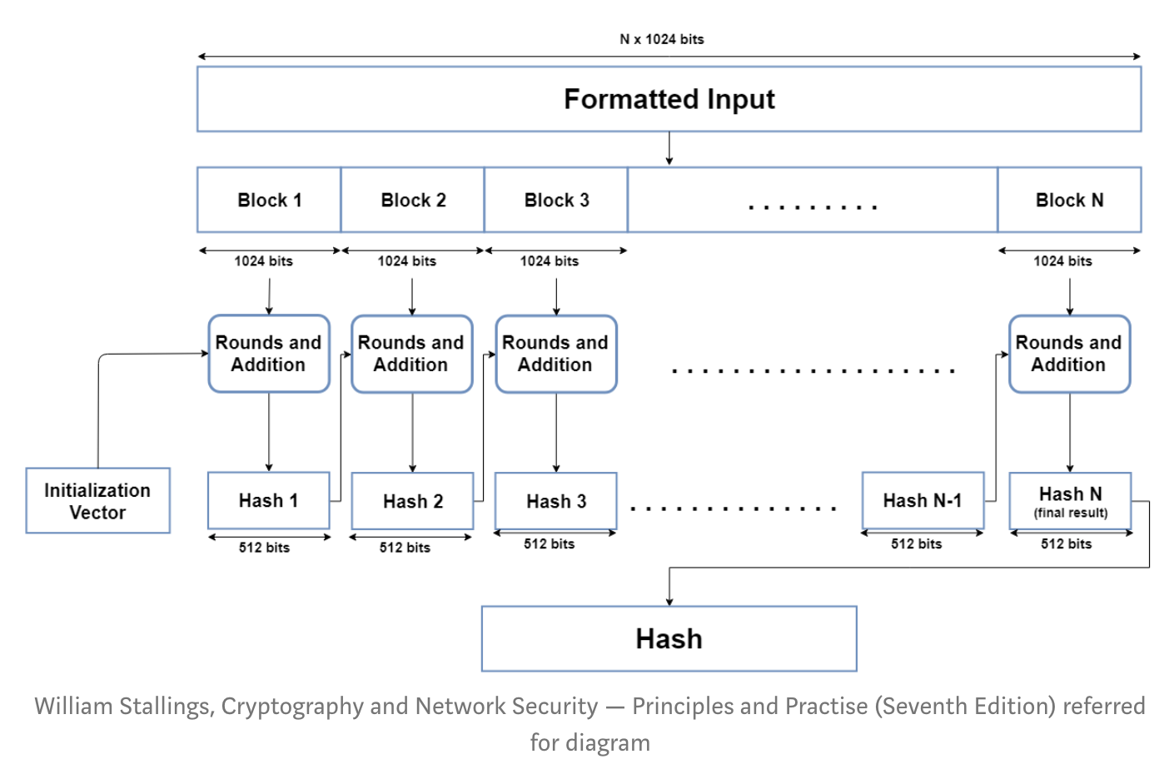
Hashing with SHA-512

Slide 11
Hashing with SHA-512 Rounds & Addition
“Sequence” a 1024-bit block into 80 64-bit “words”
Loop over the words:
Combine word i with result from previous word and SHA-512 constant i
Save result for use in next Round
Take result from last Round and perform Addition with result hash from previous block, to find result hash for this block

Slide 12
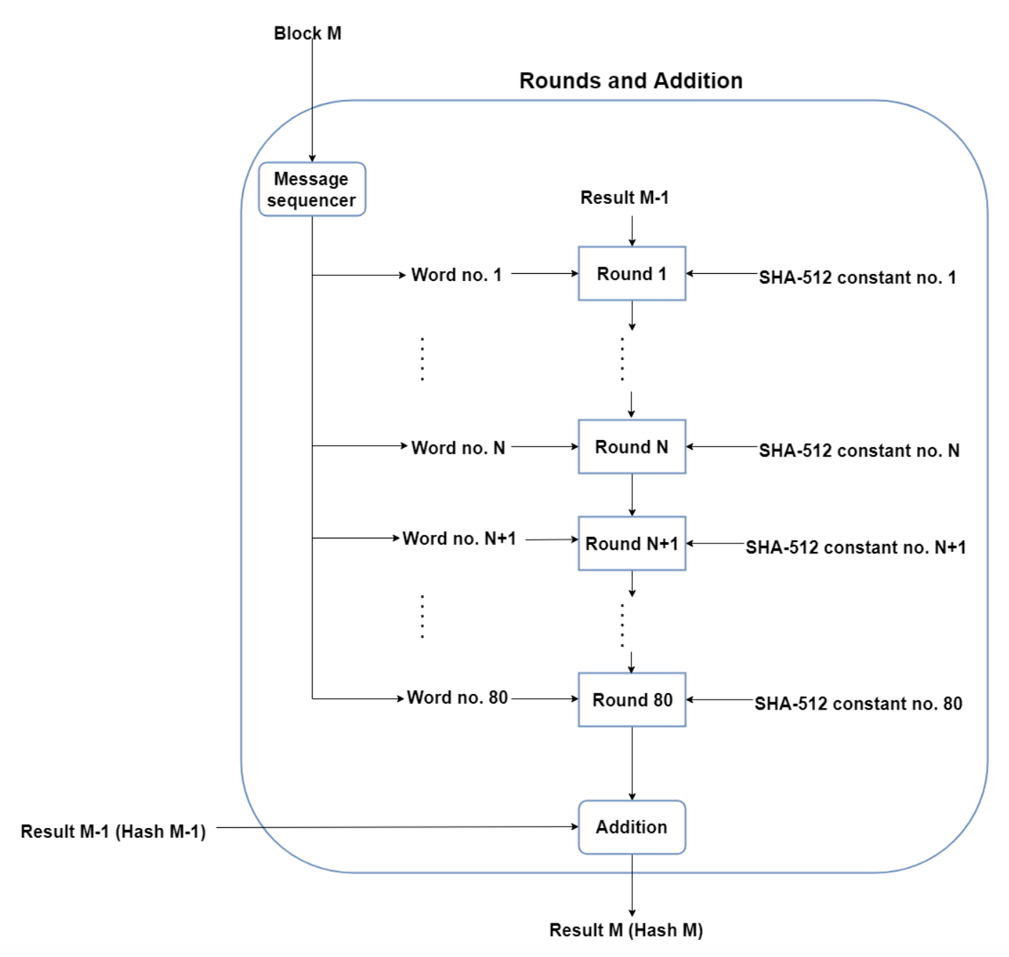
Hashing with SHA-512 Rounds & Addition

Slide 13
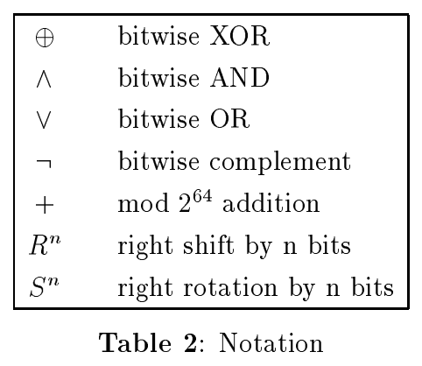
Hashing with SHA-512 – Rounds
Rounds are complicated, not covered here
Use these hard-to-invert operations:
For full spec, check http://www.iwar.org.uk/comsec/resources/cipher/sha256-384-512.pdf

Slide 14
Applications of hashing
Integrity verification: small errors (or malicious changes) will change the hash. Faster to compare just the hash.
Digital signatures: will explain how this works later, but without hashing the signature would be the size of the thing being signed. With hashing, the signature is the size of the hash.
Password storage: storing passwords in plaintext is a security risk. Instead, store the hash. When a password needs to be verified, compute the hash, compare, then throw away the password.
Proof-of-work: DDoS, Cryptocurrency
Identifiers: Git, torrents, hash tables, bloom filters
Notes:
Ask the group first.

Slide 15
Attacks on hashing: rainbow tables
Offline, precompute hashes for tons of inputs
Sort the resulting hash-input pairs on hash value
This allows quick lookup of any hash, and you’re in.

Slide 16
Hashing & Salting
Short passwords vulnerable to bruteforce attacks
Rainbow tables
Solution (partial, not perfect): salting
Append random string (the salt) to password before hashing
Store salt with hash
Bruteforce still possible but much more effort
Can’t help you if you pick one of these:
wikipedia.org/wiki/List_of_the_most_common_passwords
Notes:
sudo cat /etc/shadow
openssl passwd -6 -salt <salt> <password>

Slide 17
Attacks on salted hashing: GPUs

Slide 18
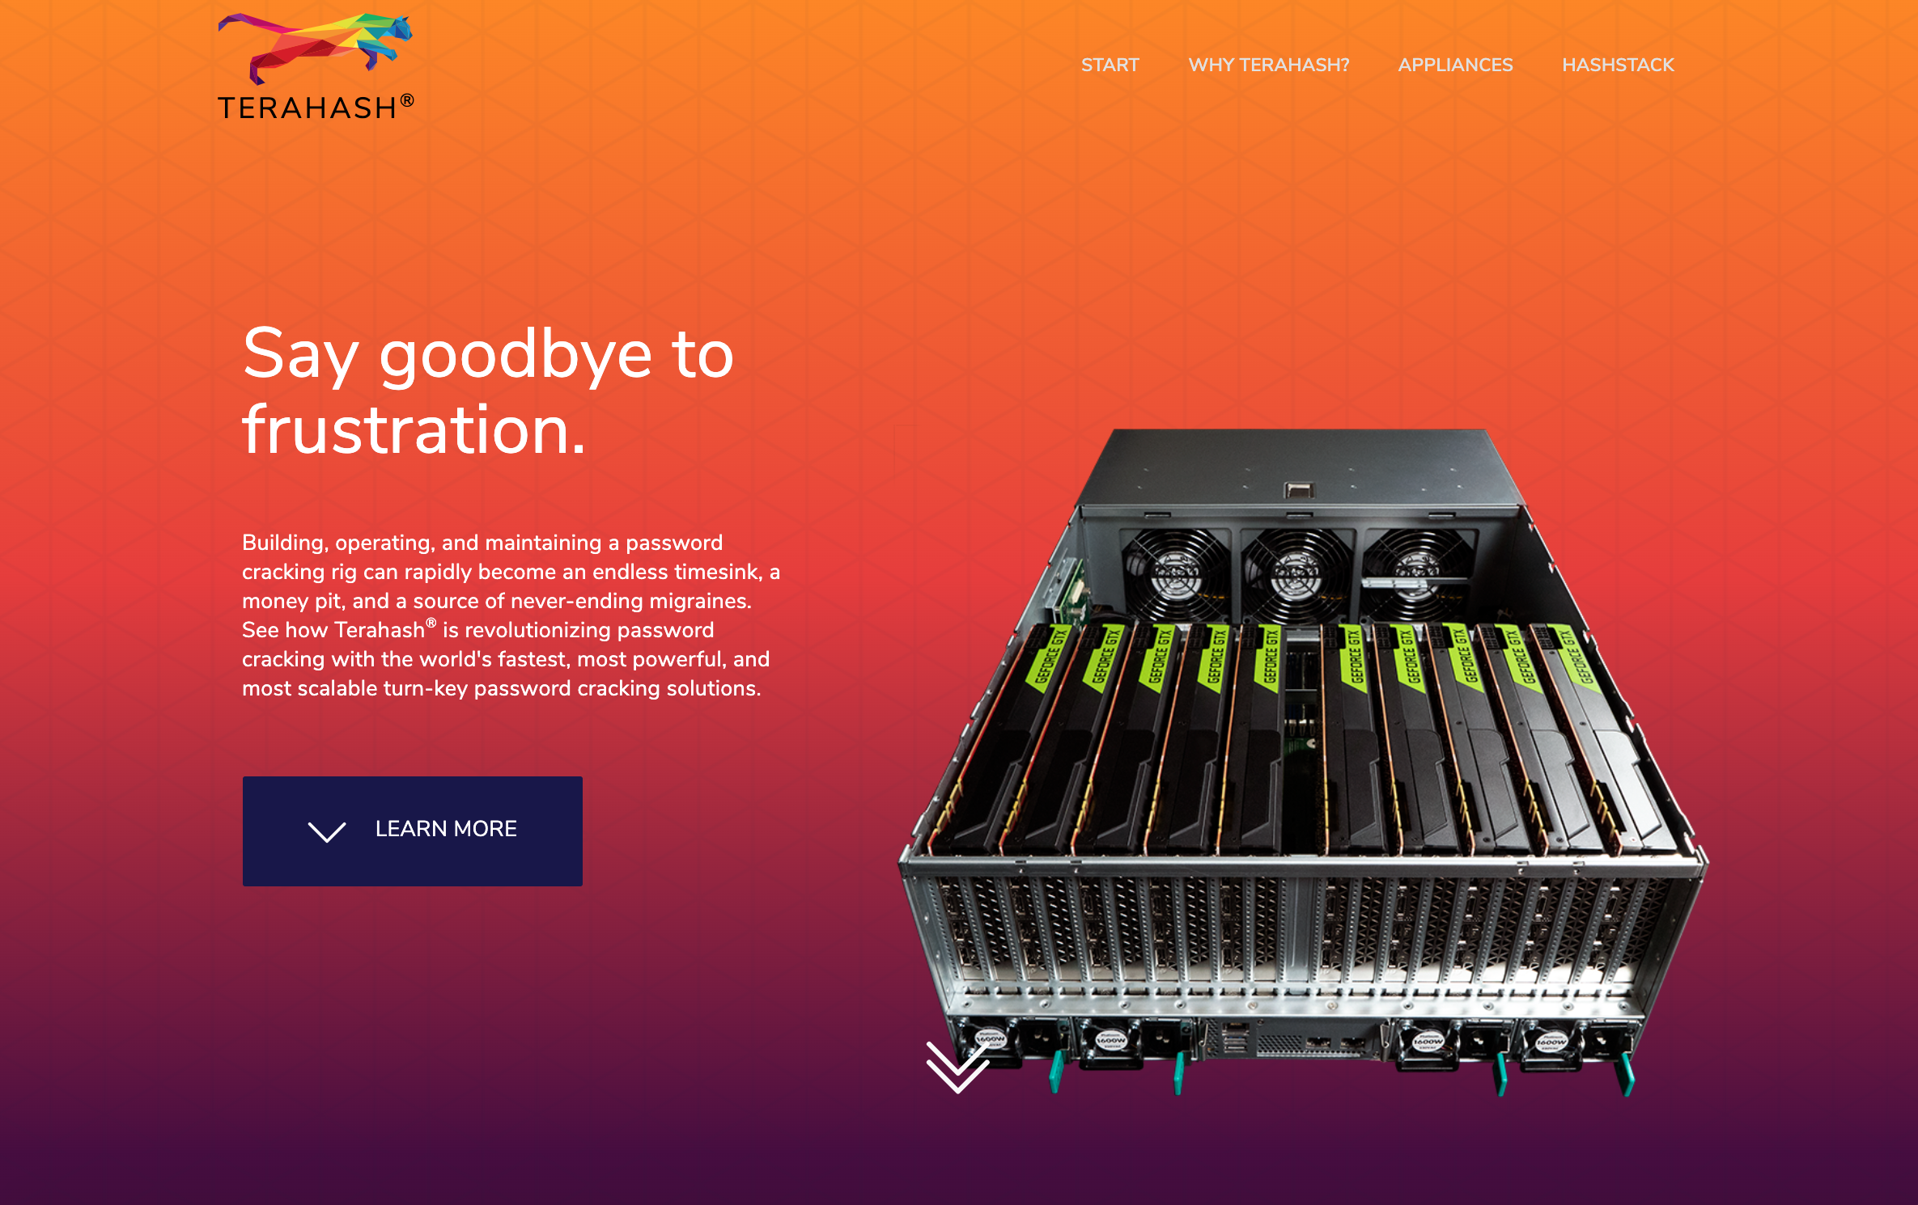
Notes:
https://terahash.com/

Slide 19
The last defense: pepper.
On top of hashing and salting, add one more ingredient: pepper.
A pepper is like a salt, but for all users.
It’s not stored in the DB.
It’s not stored in the version control system (VCS).
Even with a DB or VCS leak, the passwords are safe.

Slide 20
✓ Hashing
Any Questions?

Slide 21
Authentication & Authorization
With usernames and passwords

Slide 22
Authentication & Authorization
Authentication: Proving who you are.
Authorization: Proving what you are allowed to do.
Authorization can be handled implicitly, by attaching what you can do directly to who you are.
Authorization can also be handled explicitly, separating what you can do from who you are.
Vague? Let’s implement both.

Slide 23
Spring web app without security:
App
Servlet
Servlet
Servlet
Servlet
Notes:
Servlets bedienen specifieke endpoints

Slide 24
Spring web app with security:
App
Filter
Servlet
Servlet
Servlet
Servlet
Notes:
Filters bedienen (met default instellingen) alle endpoints

Slide 25
Spring web app with security:
App
Filter
Filter
Filter
Filter
Servlet
Servlet
Servlet
Servlet
Notes:
Filters bedienen (met default instellingen) alle endpoints

Slide 26
Spring Security default settings
Required authentication for all endpoints
Login screen
Handler for login errors
Makes user and generates password
Notes:
Gebruikersnaam is “user”, wachtwoord verschijnt in de terminal waar de app draait

Slide 27
Practice: Spring application with username & password
Notes:
https://docs.spring.io/spring-security/site/docs/current/reference/html5/#user-schema

Slide 28
Spring web app with security:
Filter
Authentication
AuthenticationProvider
authenticate()
supports()
Credentials
AuthenticationManager
authenticate()
Input
AuthenticationProvider
authenticate()
supports()
UserDetailsService
loadUserByUserName()
Output
Authentication
AuthenticationProvider
authenticate()
supports()
Credentials
Notes:
Filters bedienen (met default instellingen) alle endpoints

Slide 29
✓ Password Login
Any Questions?

Slide 30
JWT
JSON Web Tokens

Slide 31
What is a token?
Different method for authentication & authorization
Something you have, instead of something you know or are
We already used tokens, under the hood: session tokens
Spring API made session token; browser stored in cookie
Advantage: no need to send login info with each request
Disadvantage: additional secret to steal, guess or forge
Notes:
After point 4: go to browser and show JSESSIONID: dev tools, Application, Cookies.

Slide 32
Reference tokens vs value tokens
Session token we get is a ”reference token”
Just a reference, doesn’t store information
Actual information about session is held by API or database
Other option: “value token”
Stores identity and authorities on client side
Server doesn’t need to remember

Slide 33
Value tokens
Value tokens need encryption to protect against forgery
Use encryption to sign token:
Data can still be read
Changing data in token results in invalid signature
Signing is done on server-side, only server can make tokens
Different options for encryption:
Hash with secret: only server can verify signature
Asymmetric cryptography: anyone can verify signature

Slide 34
JSON Web Tokens - JWT
Open standard for value tokens
One format, but allows different encryption algorithms
Three parts, base64 encoded, with periods (.) in between:
Header, contains algorithm and token type in JSON format
Payload, contains arbitrary data in JSON format
Signature in binary format

Slide 35
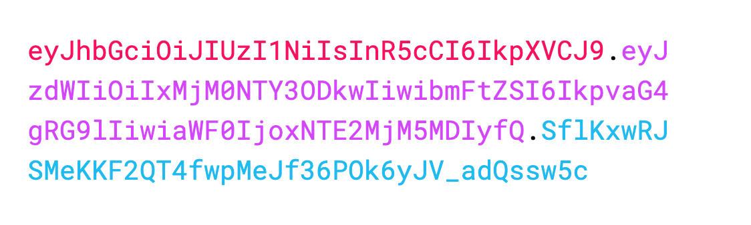
JWT Example (from JWT.io)

Slide 36
Asymmetric cryptography
Any cryptographic system where sender and receiver need different information
Receiver knows a secret, which allows them to decrypt
Sender knows only part of secret, which allows them to encrypt
Allows many senders, while keeping secret safe

Slide 37
Asymmetric cryptography
Like padlocks and keys:
Give open padlocks to anyone, keep the key for yourself.

Slide 38
Public Key Encryption
How does this work with numbers, instead of locks and keys?
Different possible methods, will summarize one: RSA

Slide 39
RSA (Rivest–Shamir–Adleman)
RSA relies on difficulty of “prime factorization”
It’s easy to create some large primes, p and q.
It’s easy to multiply 2 of these primes to get their product, n.
It’s hard to go back from the product to the original primes
How can this be used to encrypt messages?

Slide 40
RSA – Math Background
Besides prime factorization, also uses ”modular exponentiation”
a = b^{x} mod z
Example: b = 5, x = 3, z = 17
b^{x} = 125, b^{x} mod z = 6 = a
Can be proven that b^{x} mod z = ((b^{x-1} mod z) * b) mod z
Allows efficient calculation without handling huge numbers
Can be proven that (b^{x})^{y} mod z = (b^{x} mod z)^{y} mod z
This property is needed for the RSA cryptographic system

Slide 41
RSA – Algorithm Summary
Large primes p and q can be found efficiently
Product n = p*q, easy multiplication
Public key is n and e; e is arbitrary (with some conditions)
Private key is d: hard to find from n and e; easy from p, q and e
Encryption of plaintext m: c = m^{e} (mod n)
Decryption of cyphertext c: c^{d} = (m^{e})^{d} = m (mod n)
m should be smaller than n, so cut large m into chunks.
Only true for special values of d!

Slide 42
RSA – Digital Signatures
RSA can be used in reverse to produce signatures
Instead of encrypting with public key, encrypt with private key
Encryption of plaintext m: c = m^{d} (mod n)
Decryption of cyphertext c: c^{e} = (m^{d})^{e} = m (mod n)
Still hard to find d if you know c, e, n and even m.
So: anyone can read m, but can only sign if you know d.

Slide 43
Practice: Spring application with authorization token (JWT)

Slide 44
What does Spring Security do, exactly?
(1) User ID & Password
App
(2) Authentication
(3) Make JWT
(5)
Save JWT
(4) JWT to client
(6) JWT in HTTP Header
Authorization: Bearer JWT
Local Storage
or Cookie

Slide 45
Advantages of JWT over session tokens
Cryptographically secure, no guessing or forging risk
No storage needed on server side for session data
So also no time needed for lookup in database
JWT creation can be done offline: no need for login at all
Faster, just 1 round trip instead of 2
With asymmetric cryptography, can be used with other servers
Only 1 server needs to know private key, easier to secure
Other servers just know public key

Slide 46
✓ JWT Authorization
Any Questions?

Slide 47
OAuth
Service-service Authorization

Slide 48
Spring application with service-service authorization with OAuth

Slide 49
✓ OAuth Authorization
Any Questions?

Slide 50
✓ Spring Security
Thank you for your time, and best of luck with building your secure applications.

